Slide 2
Reference link
https://docs.djangoproject.com/en/3.0/intro/tutorial03/

Slide 3
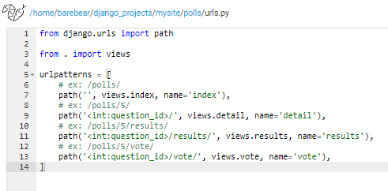
Change polls/urls.py

Slide 4
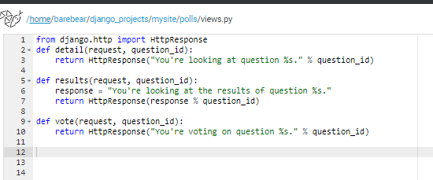
polls/views.py
Notes:
When somebody requests a page from your website – say, “/polls/34/”, Django will load the mysite.urls Python module because it’s pointed to by the ROOT_URLCONF setting. It finds the variable named urlpatterns and traverses the patterns in order. After finding the match at 'polls/', it strips off the matching text ("polls/") and sends the remaining text – "34/" – to the ‘polls.urls’ URLconf for further processing. There it matches '<int:question_id>/', resulting in a call to the detail() view like so:
detail(request=<HttpRequest object>, question_id=34)

Slide 5
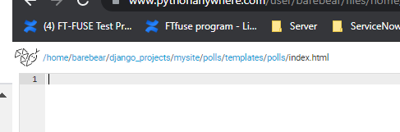
Create templates under polls directory
Create templates directory under polls
Create polls directory under templates
Create index.html under polls

Slide 6
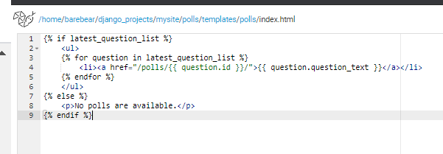
Update index.html

Slide 7
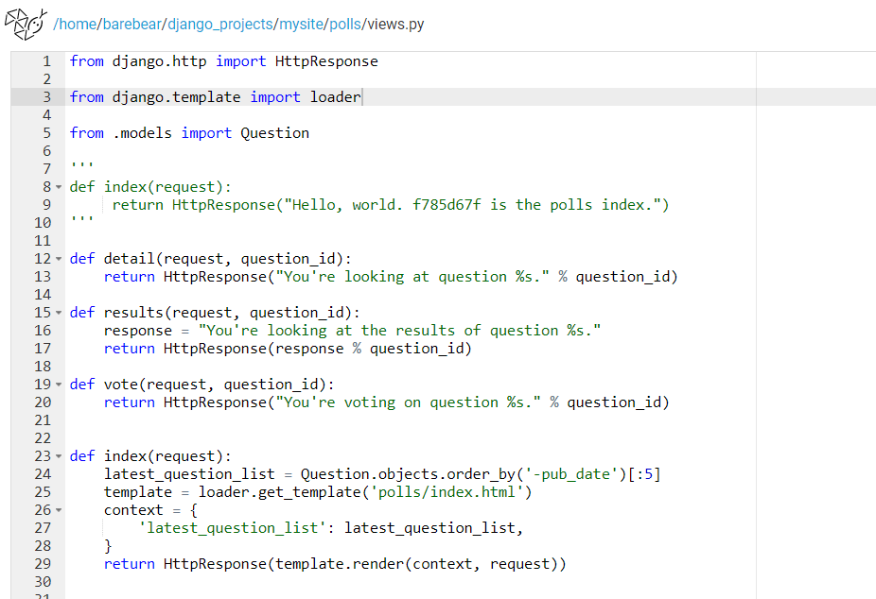
Under polls/views.py
Notes:
That code loads the template called polls/index.html and passes it a context.

Slide 8
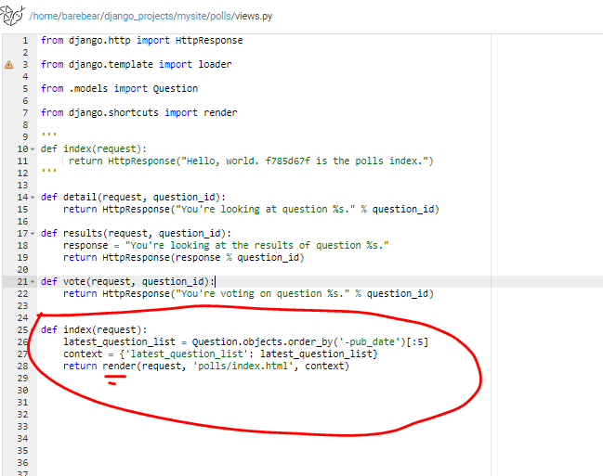
Or using render

Slide 9
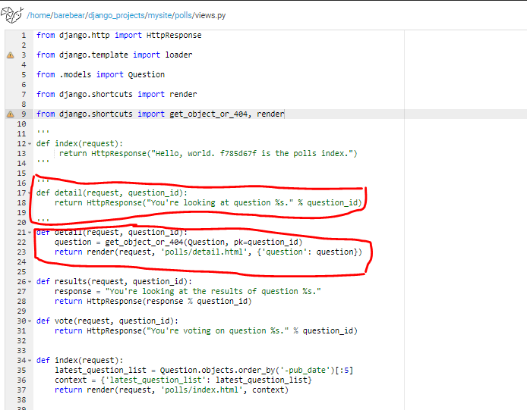
Raising a 404 error¶
Comments on the original details(request,question_id)
Notes:
get_object_or_404() raise 404 error if the question (e.g., 100) we enquired doesn’t exist.

Slide 10
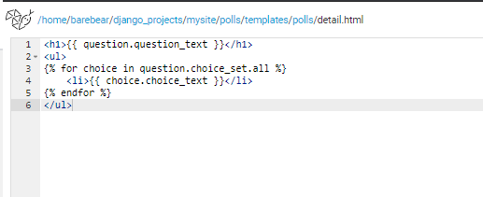
polls/detail.html
Notes:
It will list down all the choices related to the question we asked in the url

Slide 11
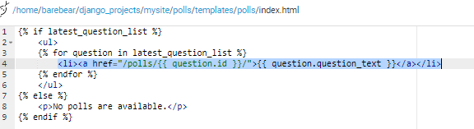
Remove hardcoded URLs in templates
In polls/index.html template, the link was partically hardcoded:
It becomes a problem if we have a lot of templates and need to change URL on everyone of them
A better approach will be show in the next slide

Slide 12
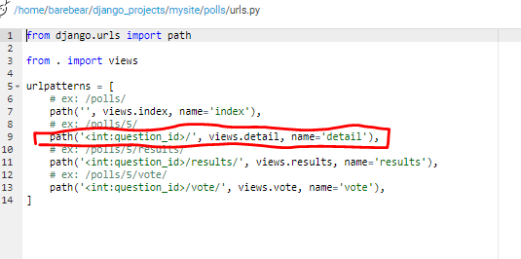
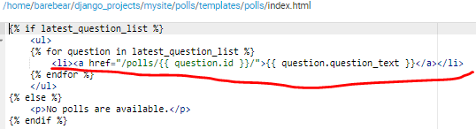
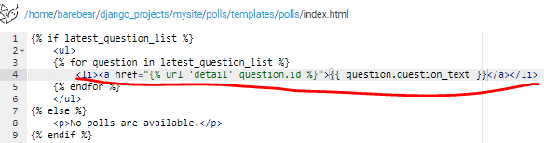
Continue…
Since the question_id is defined as “details” in polls/urls.py
We can change the index.html to:

Slide 13
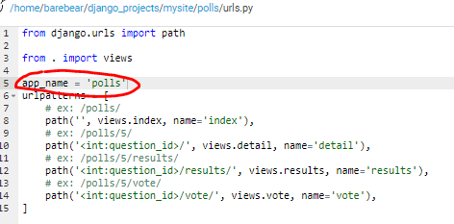
Namespacing
Add app_name under polls/urls.py
Different apps may have the same view.py files. In order to differentiate them, we add app_name in polls/urls.py

Slide 14
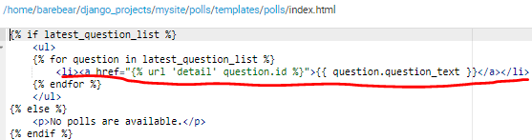
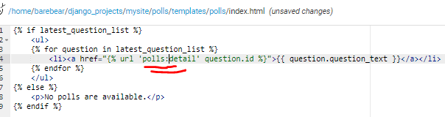
Update polls/index.html

Slide 15
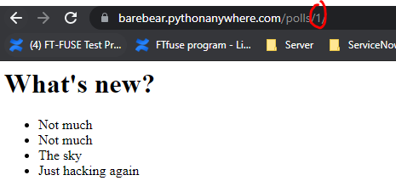
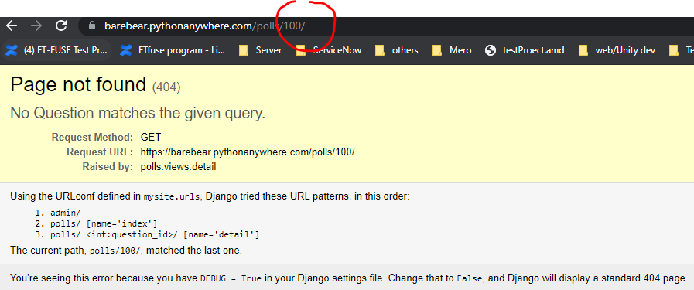
Final result…

